Slide 1
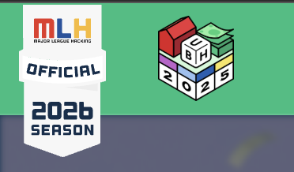
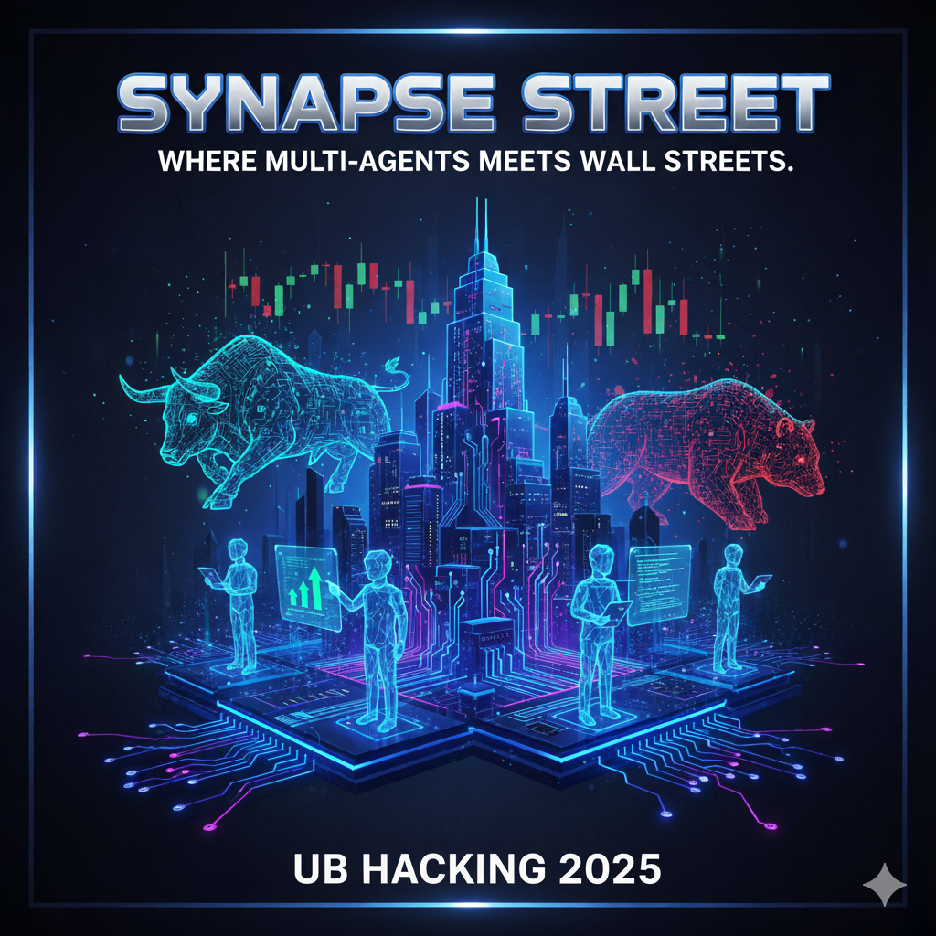
UB Hackathon 2025
Synapse Street
- Where multi-agents meets wall street
Team members –
Sathwick Kiran M S
Siddharth Adhikari
Mrudula Deshmukh
Kundan Satkar

Slide 2
Introduction and Inspiration
Synapse Street is an AI-powered multi-agent system that detects potential short-selling opportunities in the U.S. stock market.
Inspired by The Big Short, this project combines machine learning, large language models, and vector databases to identify patterns that signal overvalued or volatile stocks.
The system autonomously analyzes market data, enables collaboration between AI agents, and delivers interpretable results through interactive dashboards.
The idea for Synapse Street was inspired by The Big Short.,the story of analysts who spotted early signs of a financial collapse while the market stayed irrationally optimistic.
That principle of data-driven skepticism led us to design a system that questions market sentiment using evidence and AI reasoning.
Three agents., Analyst, Model, and Risk, work together like a digital hedge-fund team, detecting shorting opportunities before they become obvious to everyone else.

Slide 3
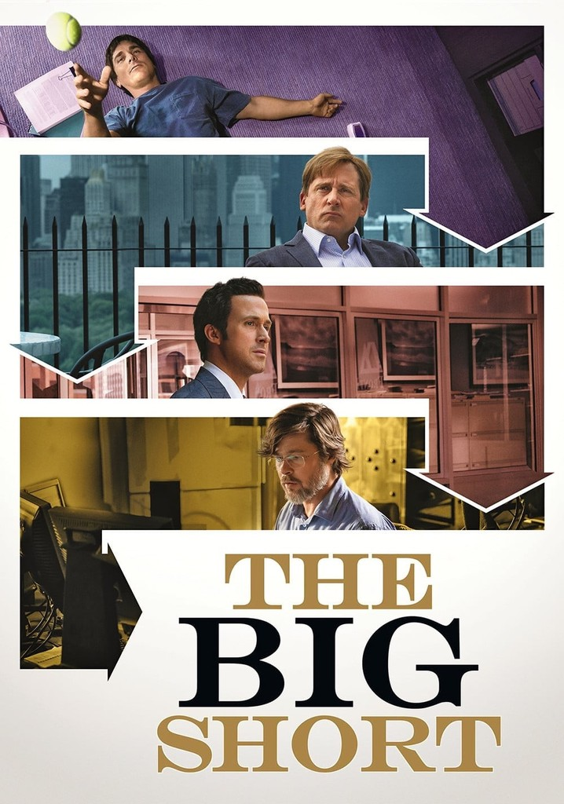
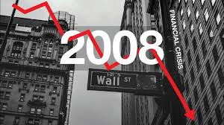
What are we achieving?
Synapse Street integrates multiple AI and data components to:
Process large-scale historical U.S. stock data (Kaggle: U.S. Stock Market History).
Clean, standardize, and engineer features using Pandas with Hadoop (HDFS-ready).
Apply a Logistic Regression model to compute short probabilities for each ticker.
Store market observations as embeddings in Qdrant for vector similarity search.
Orchestrate three LangGraph agents:
Analyst Agent – detects high-volatility and overbought tickers.
Model Agent – evaluates short probabilities and model metrics.
Risk Agent – assesses exposure and creates interpretable narratives.
Present results in an interactive Streamlit dashboard (deployed via HuggingFace) and Tableau analytics views.

Slide 4
Tech Stack
LangGraph
Qdrant
Scikit-learn
A multi-agent system for collaborative decision-making
A vector database for efficient similarity search
Machine learning library for predictive modeling
Hadoop
Plotly
Streamlit
Data visualization library for interactive dashboards
Framework for building web-based user interfaces
HDFS for parallel processing and handling big data.

Slide 5






Architecture Overview
Stock Data
Feature Engineering
ML Model
3 AI Agents
Vector Search
Top 10 Picks
Gather historical stock market data from various sources, such as financial databases, APIs, and public data repositories.
Extract and engineer relevant features from the stock data, including technical indicators like RSI, moving averages, and volatility, as well as fundamental metrics like 20-day returns.
Train a machine learning model, such as a logistic regression with calibration, to predict the likelihood of a stock being a short candidate based on the engineered features.
Leverage a multi-agent system with three specialized agents: a Financial Analyst, a Risk Assessor, and a Strategist. These agents collaborate to analyze the model's outputs and identify the most promising short candidates.
Use a vector database like Qdrant to perform semantic search and find stocks with similar patterns to the identified short candidates, rather than relying on keyword-based search.
Present the top 10 short candidates identified by the AI system, based on the collaboration between the three agents and the vector search results.

Slide 6
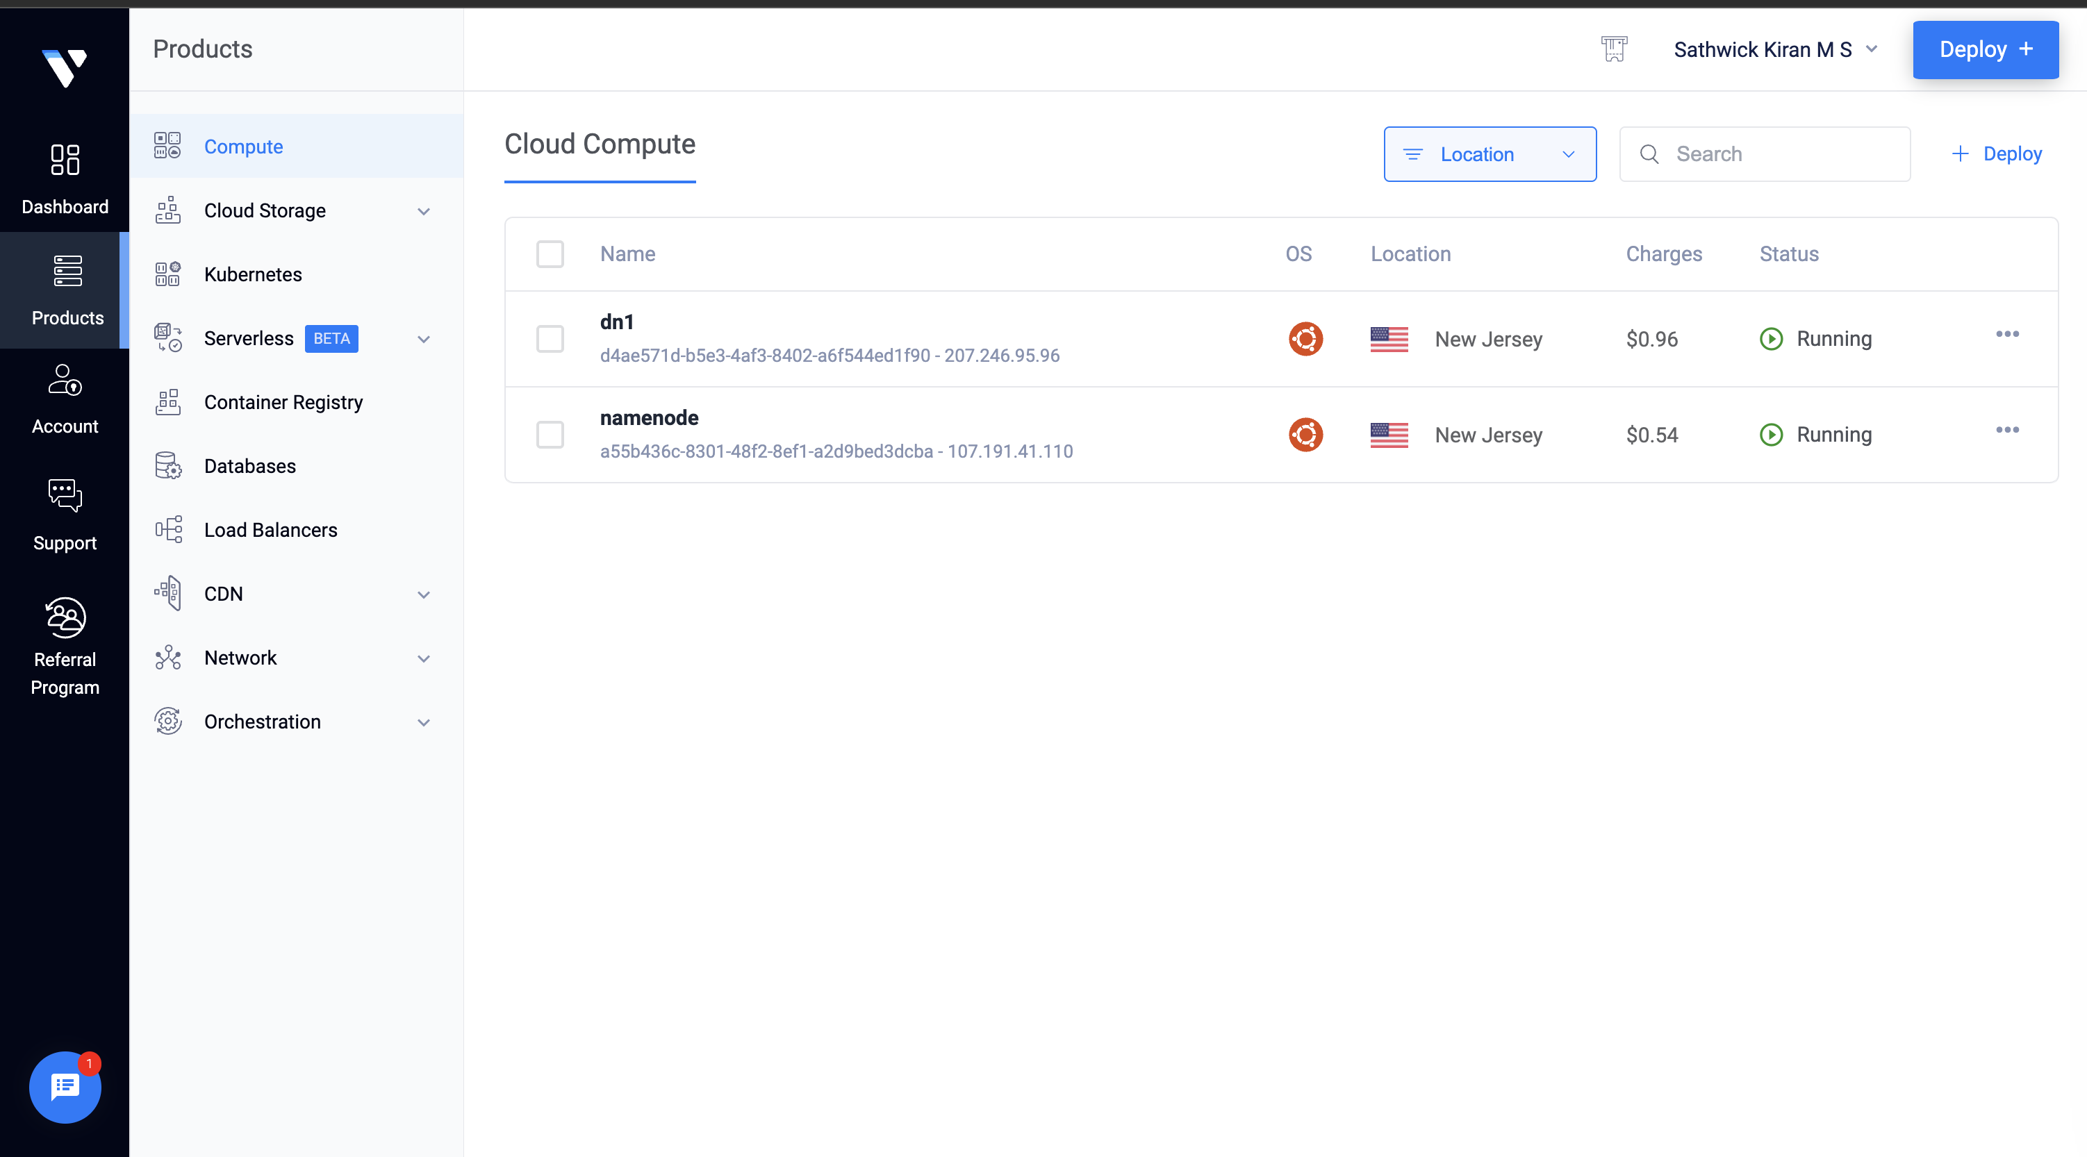
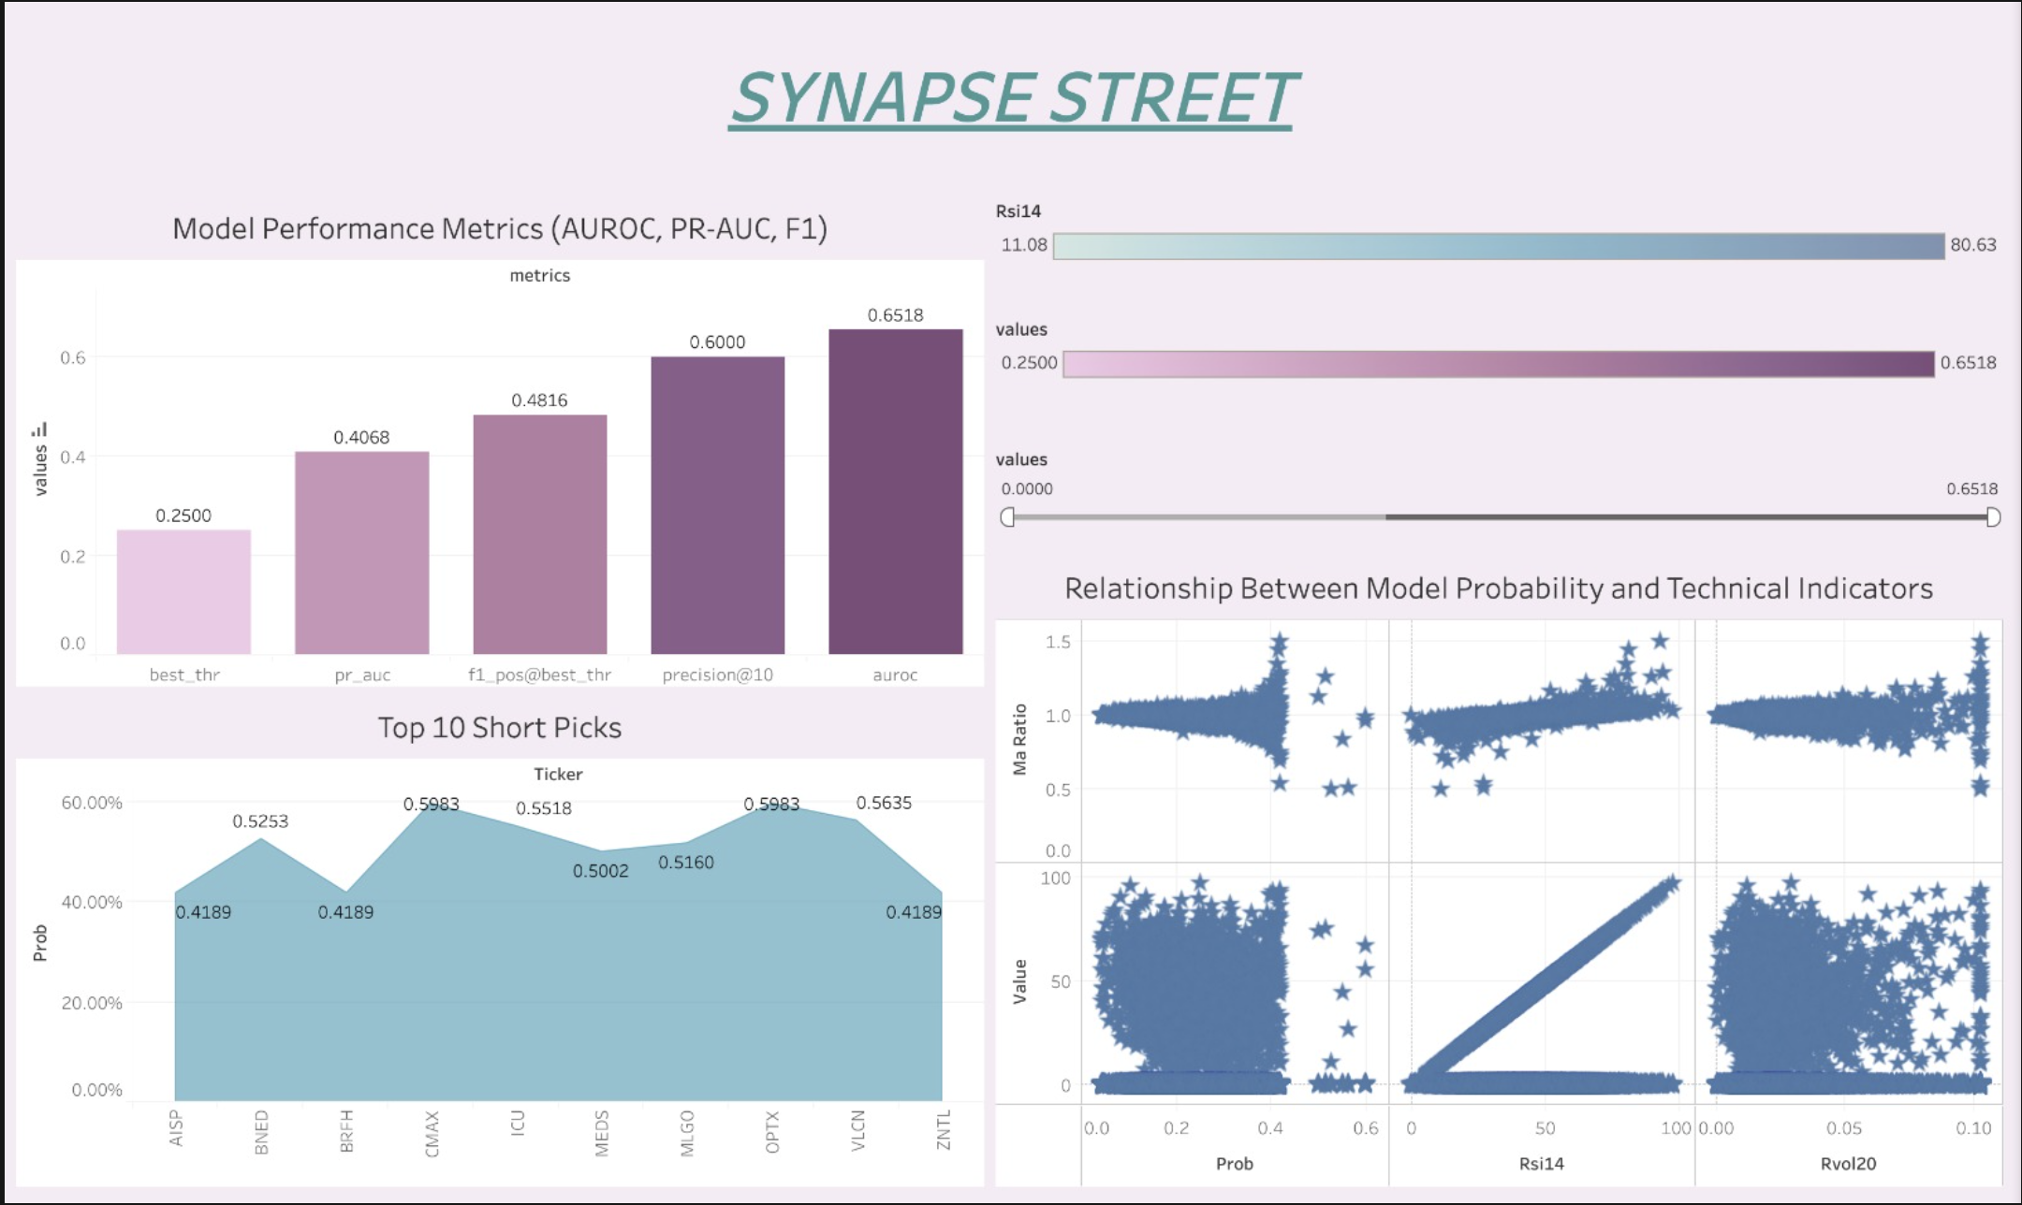
Visualization
Streamlit dashboard showing probabilities, narratives, and metrics.
Tableau dashboards for performance and feature trend visualization.
Infrastructure – Deployed a distributed HDFS environment on Vultr Cloud supporting collaborative reads/writes from Kaggle notebooks.

Slide 7
Challenges and Accomplishments
Connecting Kaggle notebooks to a remote HDFS cluster within time limits.
Managing and preprocessing ~5 GB of data under runtime and memory constraints.
Handling Qdrant embedding fallbacks when the fastembed module was unavailable.
Debugging LangGraph dependency chains and inter-agent state flows.
Deploying Streamlit inside Kaggle, where port 8501 access is blocked.
Building integrated Tableau dashboards from exported artifacts.
Delivered a complete end-to-end multi-agent AI system within a 15-hour hackathon.
Integrated LangGraph, Qdrant, and Scikit-learn into one cohesive finance pipeline.
Achieved AUROC = 0.64 and F1 = 0.45 as baseline model performance.
Produced clear Tableau and Streamlit dashboards for explainable insights.
Published the full system on GitHub for transparency and reproducibility.
7

Slide 8
What we learnt and next steps
Learning Outcomes -
Designing AI agents to collaborate on financial reasoning tasks.
Using vector search (Qdrant) for contextual retrieval in quantitative workflows.
Structuring multi-agent orchestration with LangGraph StateGraphs.
Managing high-volume financial data with HDFS + Pandas pipelines.
Balancing computational speed and interpretability during rapid prototyping.
Next Steps -
Integrate LLM commentary (GPT-5 / Claude API) to generate market summaries.
Deploy a live Streamlit web app via HuggingFace Spaces.
Connect to real-time stock market APIs (Polygon, Alpha Vantage).
Expand to five agents, adding News Sentiment and Portfolio Optimization roles.
Include backtesting and risk-adjusted return metrics (Sharpe Ratio dashboards).

Slide 9
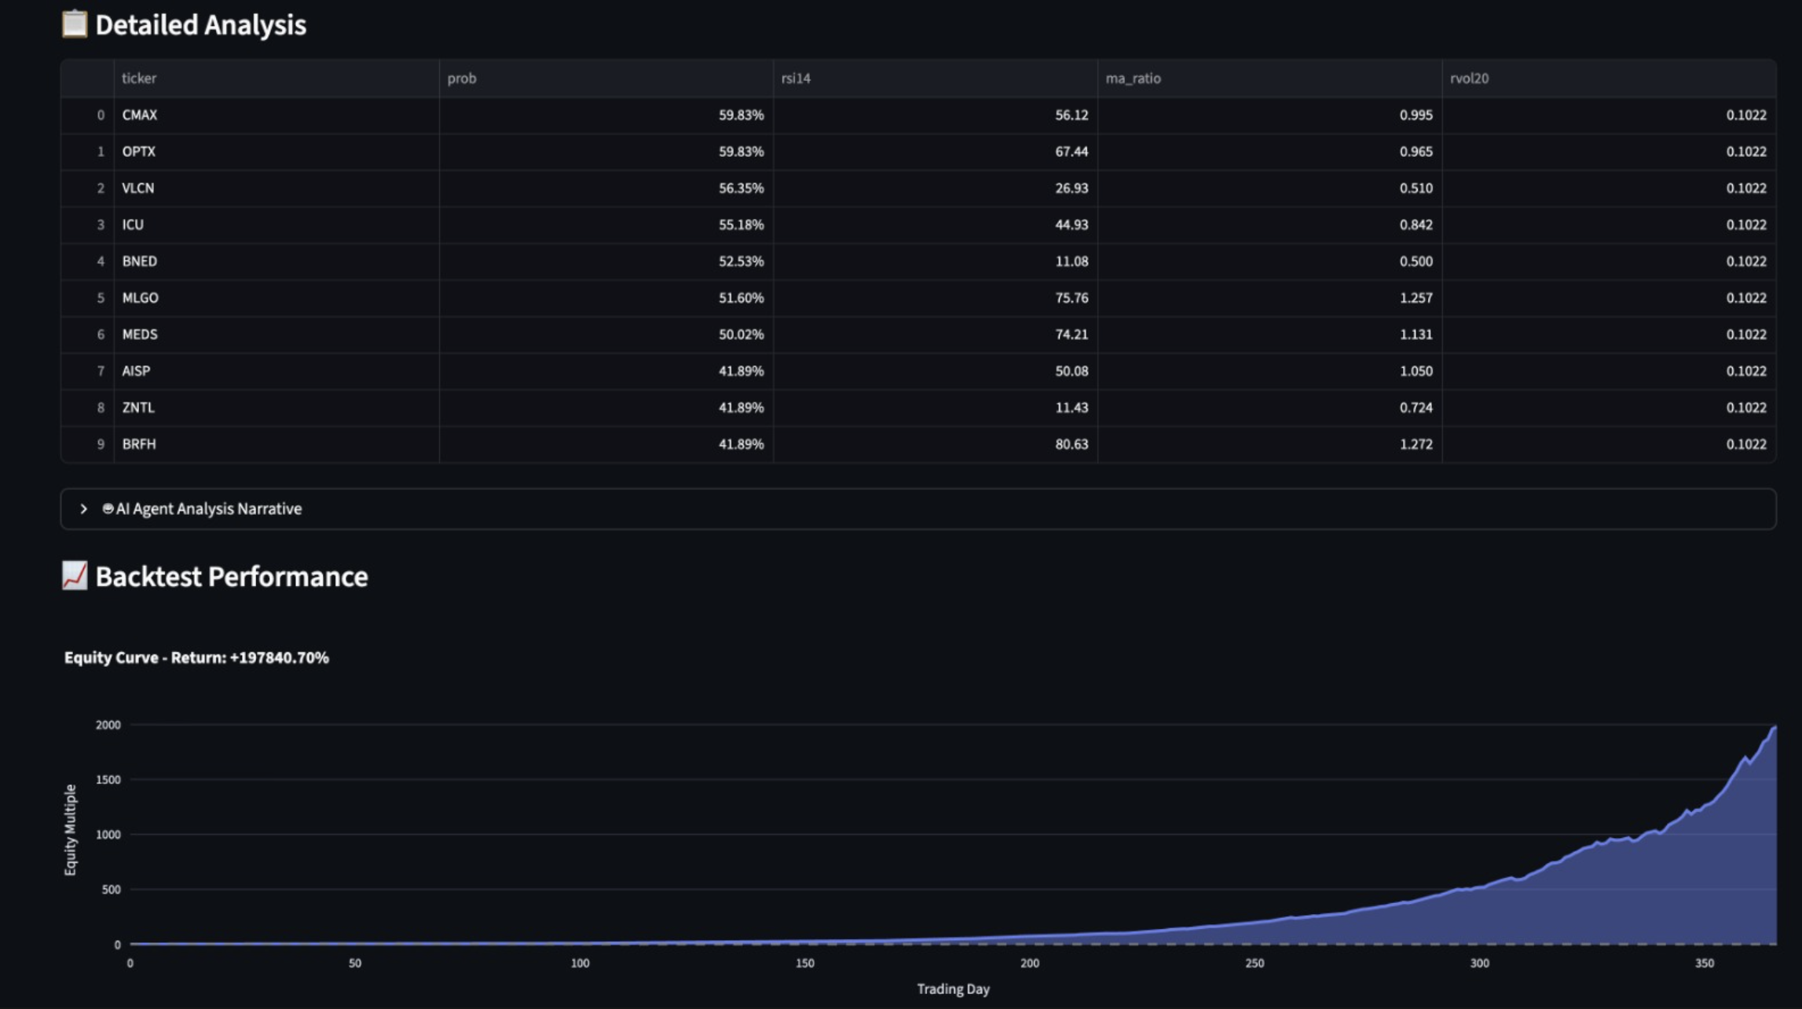
Results
Results
Top 10 short candidates, +18% backtest return, 3,231 stocks analyzed
60%
18%
1 M+
Precision@10
65%
Backtest Return
AUROC
Stocks Analyzed

Slide 10
Conclusion
Successfully Implemented following things in the project:
Initialization of the Hadoop Server via Vultr.
Building and Modeling of ML models.
Initialization and use of LLM model for shorting of stocks.
Visualizing the Charts, results and Analysis report.
Developing the Streamlit App via Streamlit.
Implementing a Tableau Dashboard for visualizing the acquire data reports.

